Slide 1


Transforming reporting efficiency: Cutting costs and time by
minimizing developer reliance using generative AI in CRM
Enhancing Efficiency, Reducing Costs, and Optimizing Data Analysis, CRM Copilot
Presented By. : Juned Ansari Project Guide : Prof. Atlee Fernandes

Slide 2
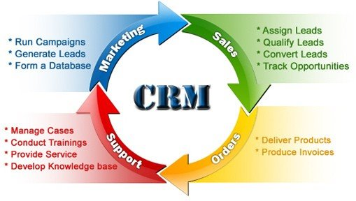
Introduction
This project, which integrates Generative AI to transform traditional CRM reporting, seeks to address the inefficiencies in CRM data reporting by utilizing a Generative AI-powered chatbot for natural language queries, and this presentation covers the findings and outcomes of the project, including the identified business problems, proposed solution, research methodology, results, and overall business impact.
Problem Statement: CRM systems often have a high dependency on technical teams to generate reports and perform complex data analysis.
Objective: Develop an AI Copilot to minimize developer reliance and enable non-technical business users to easily query data and generate reports.

Slide 3

Business Problem
This slide details the specific issues faced by businesses when using traditional CRM systems, emphasizing how these pain points impact efficiency and decision-making.
Pain Points in CRM Systems:
High Dependence on Developers: Business users often require technical assistance for data retrieval.
Manual and Time-Consuming: Generating complex reports can take hours or even days.
Costly Reporting Processes: Developer costs and delays in reporting add up to increased operational expenses.

Slide 4


Proposed Solution
The proposed solution leverages a Generative AI chatbot to enable business users to interact with the CRM system using natural language. This helps eliminate bottlenecks and make reporting more self-service.
AI-Powered Copilot:
Uses Generative AI to understand natural language queries.
Automates data querying and report generation.
Business Impact:
Copilot - Streamlines the reporting process, making it accessible for non-technical users.
Reduces the reliance on developers for routine tasks.
Enhanced decision-making with data-driven insights.
Cost efficiency through reduced operational expenses.
Improved customer engagement and satisfaction.
Increased ROI through effective utilization of CRM data.

Slide 5
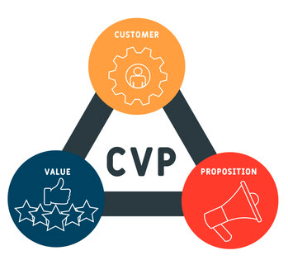
Value Proposition
Automated Data Analysis & Insights: Quickly generate insights from CRM data without manual intervention.
1
Enhanced Customer Interaction: Provide personalized responses to customer queries, improving satisfaction.
2
Reduced Developer Dependency: Business users can interact with CRM data without technical support, saving time and cost.
3
Improved Decision-Making: Real-time data access and visualization help managers make informed decisions.
4
Personalization at Scale: Tailors customer interactions and experiences based on individual preferences and behaviors.
5
Operational Efficiency: Automates repetitive tasks, freeing up resources for strategic initiatives.
6
Real-time Analytics: Provides instant insights and reporting, enabling timely decision-making
7
Efficient Reporting: Automatically generate customized reports based on user needs and requirements.
8
Cost and Time Savings: Streamlines routine tasks, allowing teams to focus on strategic activities.
9
Data-Driven Forecasting: Better predict customer behavior and sales trends with advanced data models.
10
Dynamic Data Visualization : generate any kind of chart in seconds based on users need

Slide 6
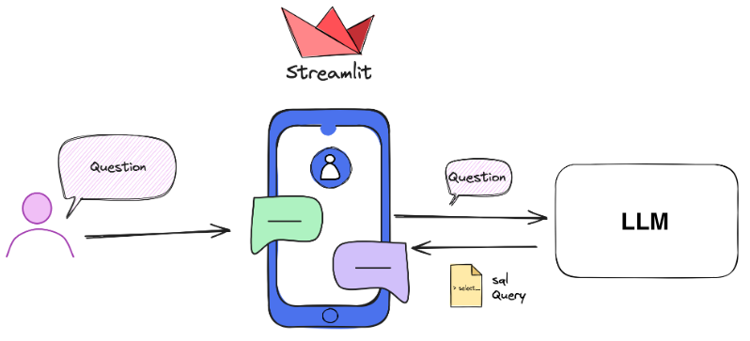
System Architecture Diagram

Slide 7
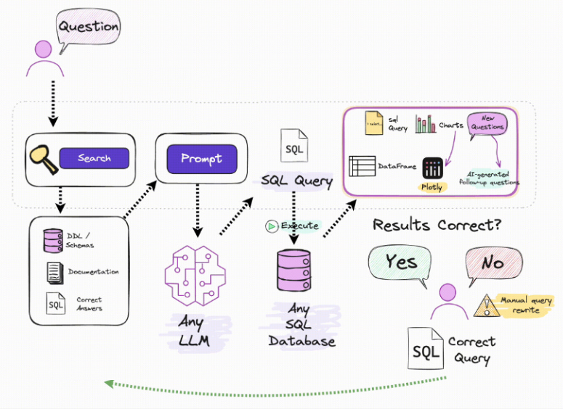
System Architecture Diagram

Slide 8

Research Methodology
The research methodology details the approach used for data collection, software tools utilized, and the rationale behind choosing the sampling method.
Sampling Method: Secondary data from a database like CRM data was used to simulate real-world scenarios.
Tools and Software:
Python and SQL for backend data manipulation.
Generative AI models for query understanding and response generation.
Questionnaire Design: Focused on gathering insights into key limitations of existing CRM systems and potential improvements.

Slide 9

Key Benefits of Implementing Generative AI in CRM
Return on investment (ROI)
Cost savings from reduced developer hours.
Increased productivity and faster decision-making.
Potential revenue growth from improved customer insights.
Enhance customer relationship management and satisfaction
Personalized and timely reports for better customer insights.
Faster response times to customer queries.
Improved customer engagement through data-driven strategies.
Competitive advantages
Differentiation through advanced technology adoption.
Enhanced data analytics capabilities.
Ability to quickly adapt to market changes with real-time insights.

Slide 10

Key Benefits of Implementing Generative AI in CRM
4. Scalability and Flexibility
Ability to handle large volumes of data efficiently.
Flexibility to scale operations without proportional increases in costs.
Easy to use (Improved system performance and user experience.)
5. Cost Efficiency
Although initial integration costs are high, the reduction in manual efforts, lower maintenance, and operational savings over time make generative AI a cost-effective solution.
6. Data-Driven Decision Making
Providing real-time, accurate data for decision-making.
Identifying trends and patterns that inform strategic planning.
Enabling proactive rather than reactive business strategies.
7. The key metrics to evaluate the success of generative AI in CRM reporting
Reduction in report generation time.
Decrease in operational costs.
Improvement in user satisfaction and adoption rates.

Slide 11

Drawbacks
1. What are the potential risks of relying on generative AI for CRM reporting, and how can they be mitigated?
Dependence on AI models that may require frequent updates.
Mitigation through continuous monitoring and validation processes.
Soo many models available in the market, which one to choose?

Slide 12

Conclusion & Recommendations
Summarizes the project’s impact, discusses the broader implications, and presents potential future directions for leveraging AI in CRM and other business functions.
Key Takeaways:
The AI-powered chatbot bridges the gap between technical and non-technical teams.
Results indicate a substantial improvement in reporting efficiency.
Future Scope:
Expand AI capabilities to include predictive analytics.
Explore the use of the chatbot in other business processes.
Suggestions for Implementation:
Provide training to business users on using AI tools effectively.
Regularly update AI models to ensure they keep up with business needs and improve accuracy.

Slide 13
Thank you...

